Slide 1
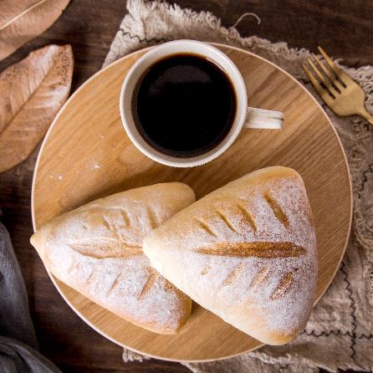
T302 Infographic
Abril Chloe Cao

Slide 2
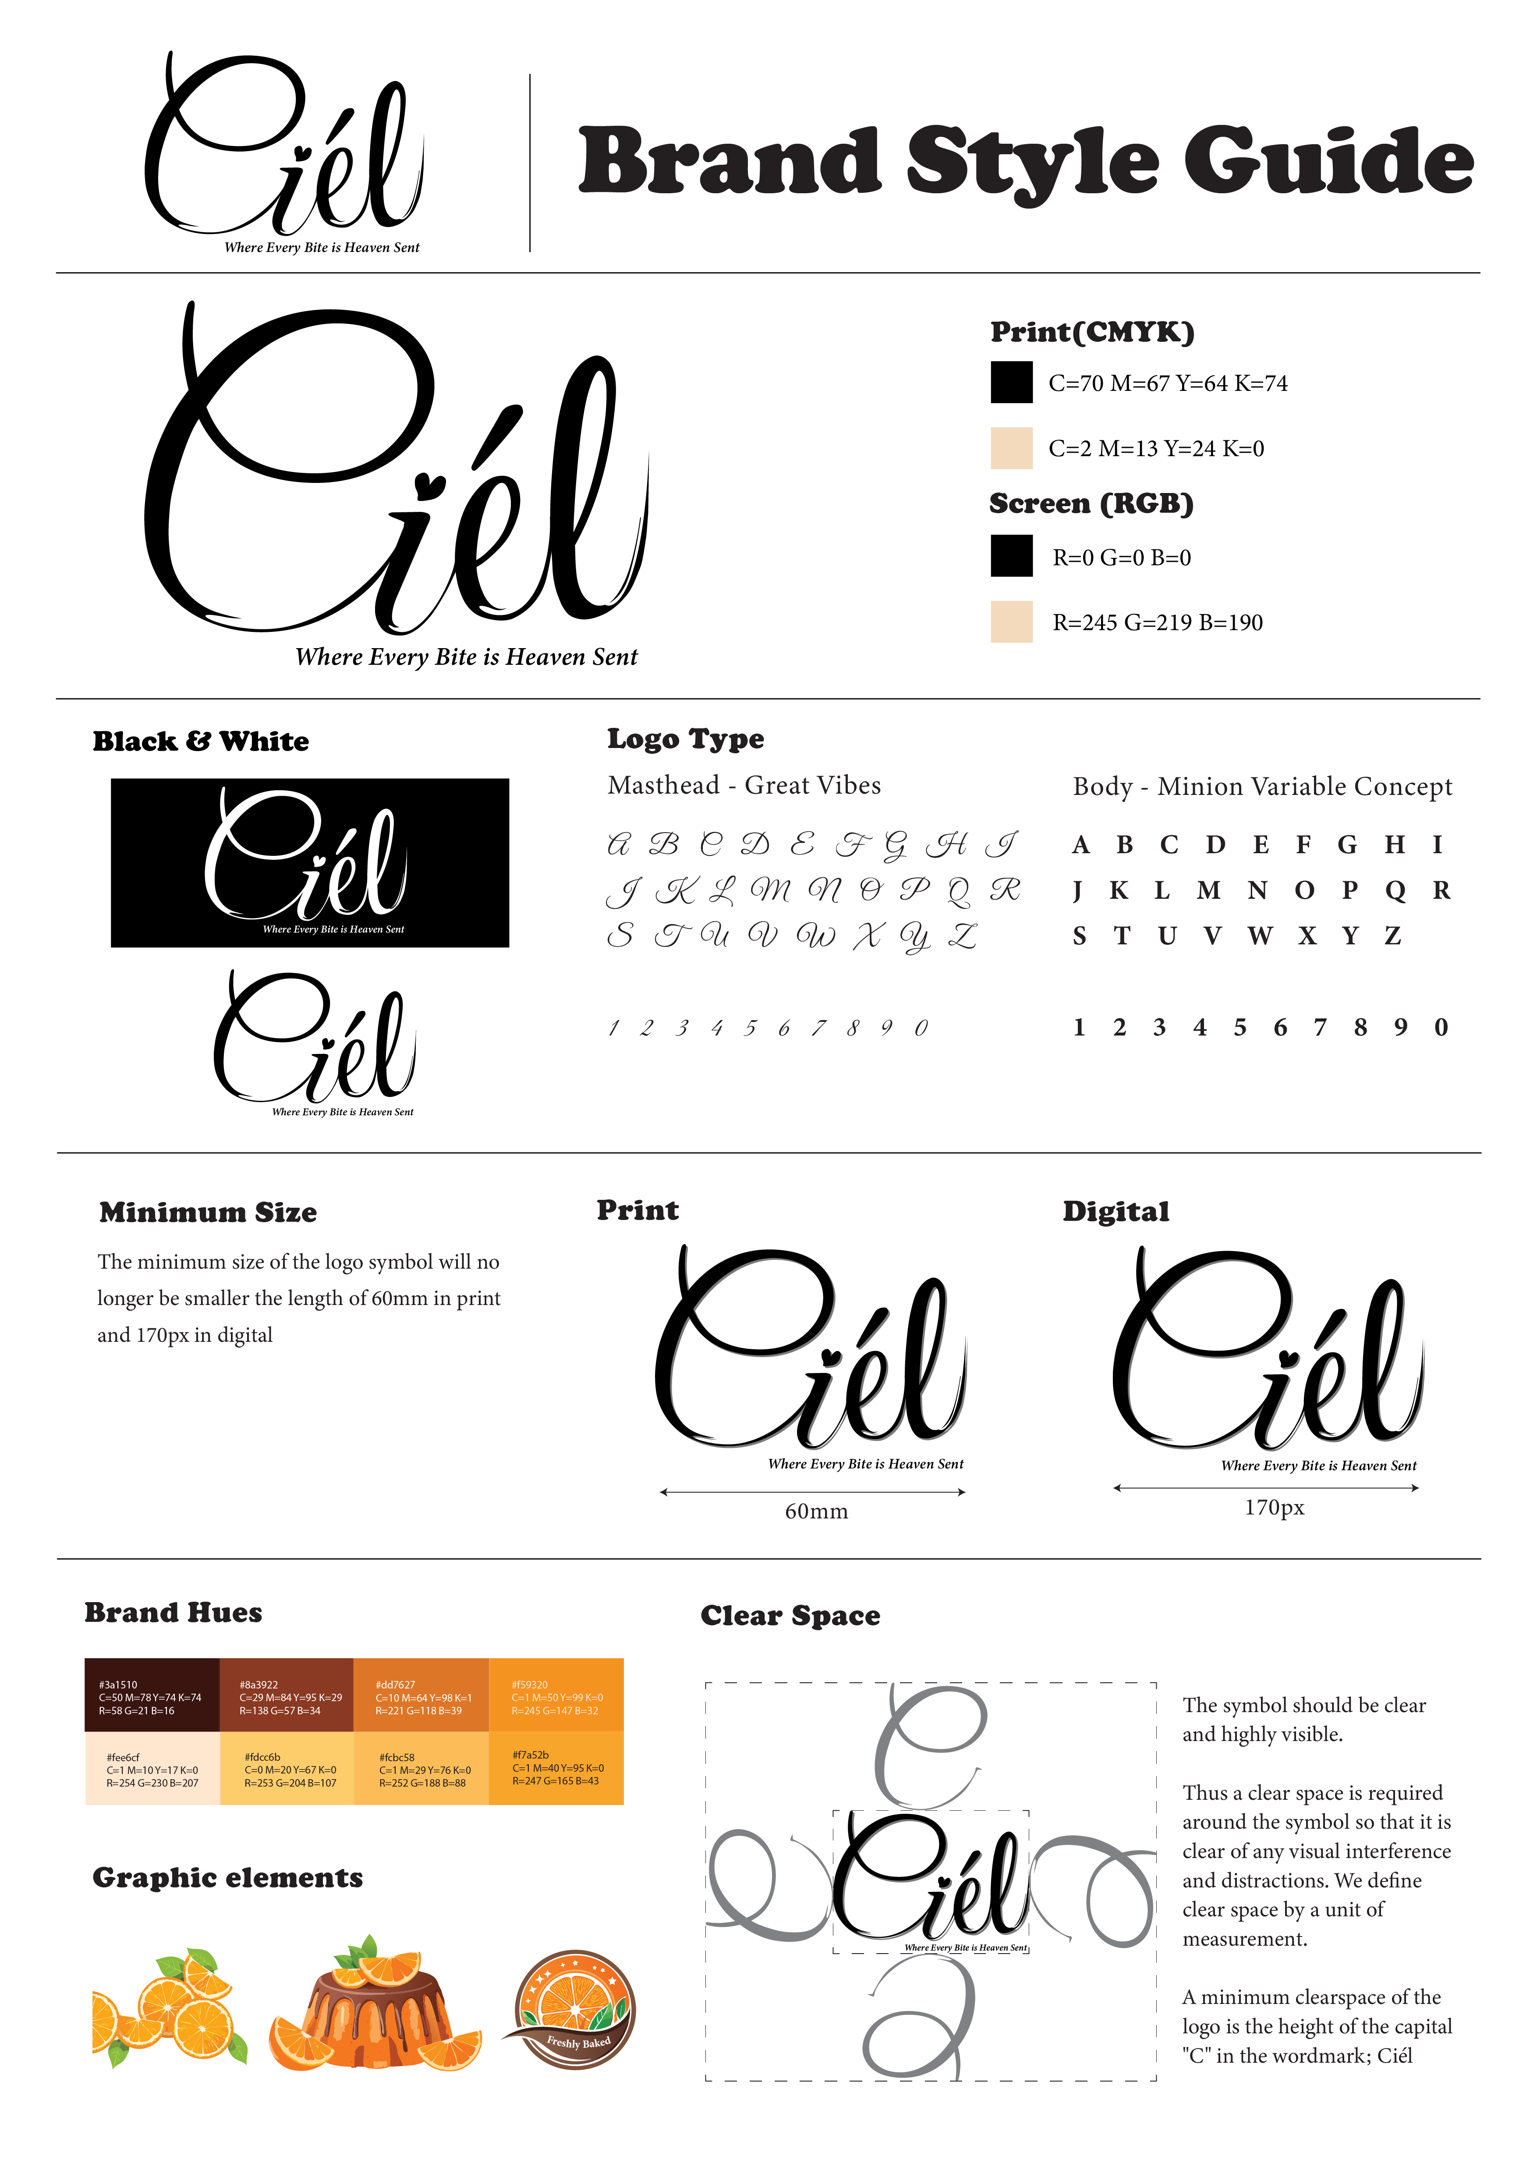
Style Guide

Slide 3


Colour Palette

Slide 4
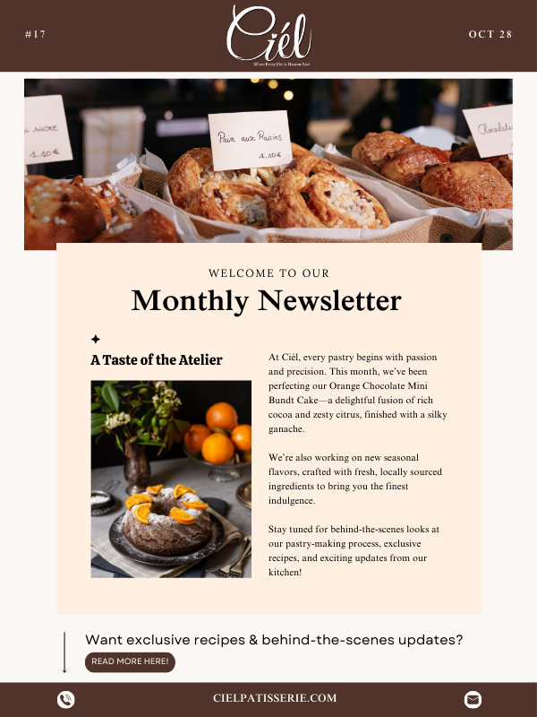
Email Newsletter
This newsletter for Ciél Pâtisseriel incorporated a design layout that feels warm, inviting, and aligned with the brand’s artisanal and elegant identity.
I chose a sophisticated yet cozy and consistent color palette, incorporating warm browns and creams to evoke a sense of indulgence and craftsmanship. The header image of the pastries immediately draws attention. I also used a serif font to add that handcrafted feel, reinforcing Ciél’s dedication to both tradition and refinement.
The "Taste of the Atelier" section introduces Ciél’s latest creations while keeping the text concise and appealing. I included a call-to-action button at the bottom to encourage audience interaction, making it easy for readers to explore more exclusive content.

Slide 5

Email Newsletter

Slide 6
PPT Templates

Slide 7
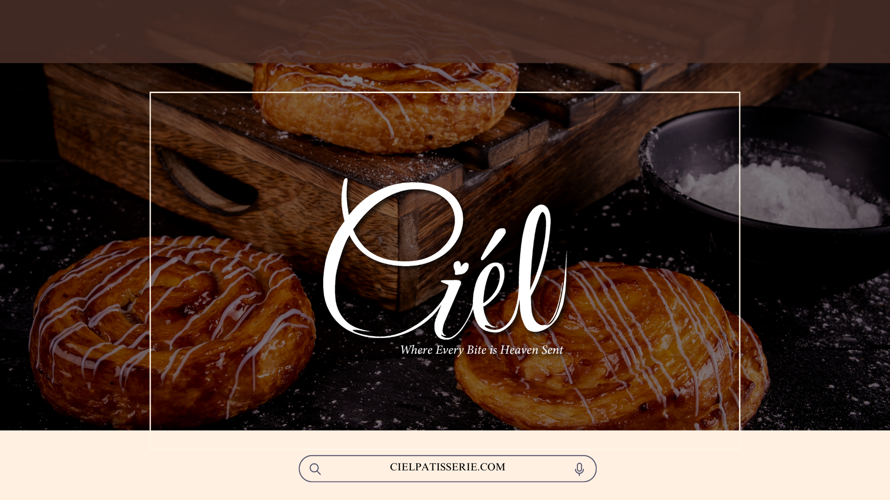

Slide 8
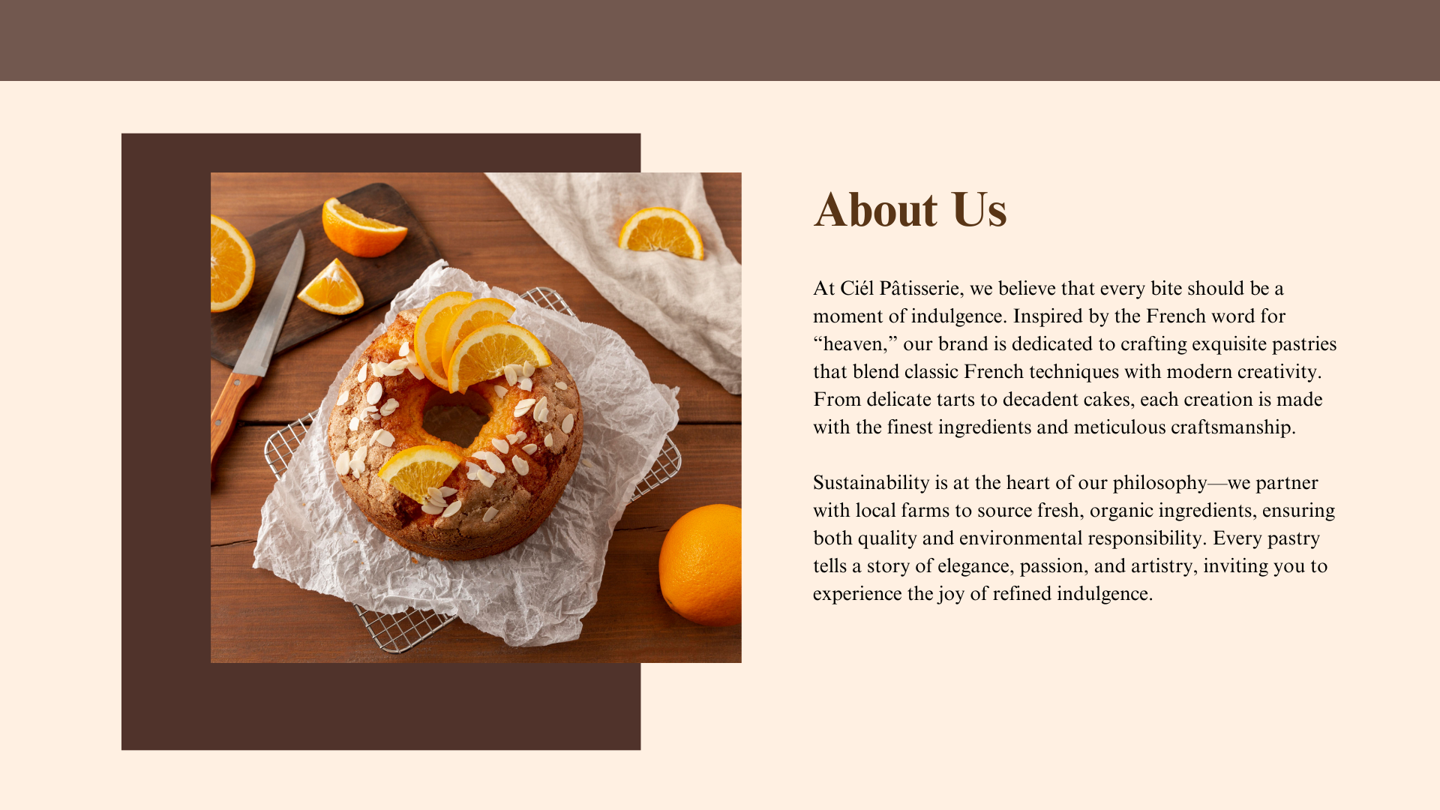

Slide 9
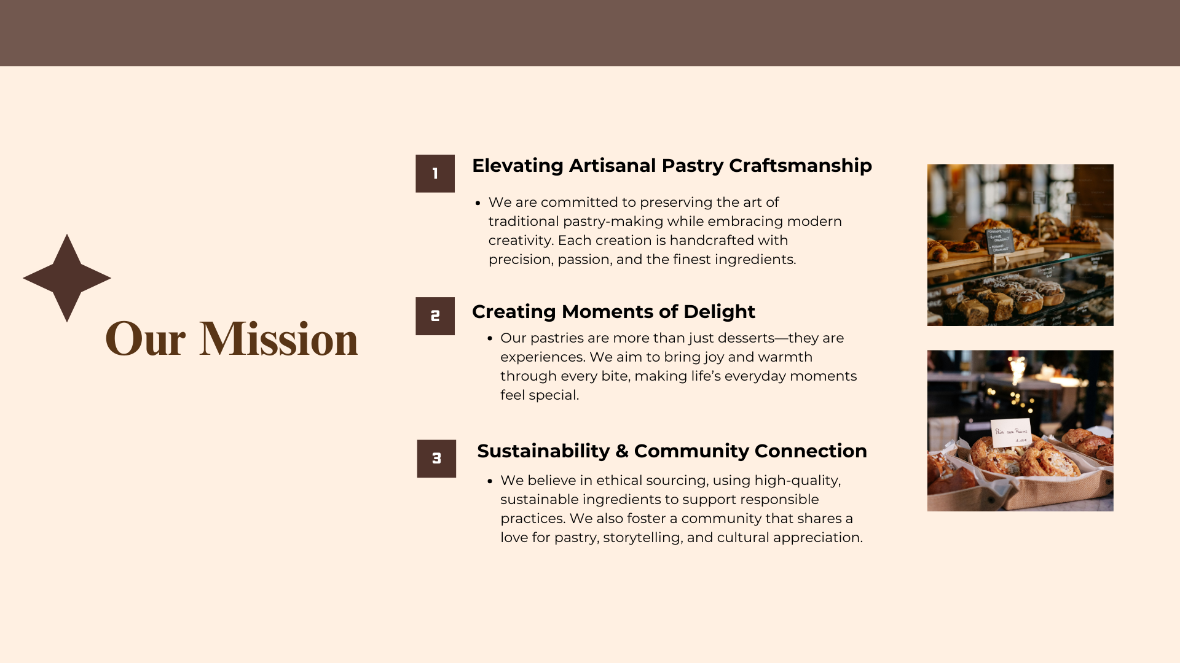

Slide 10
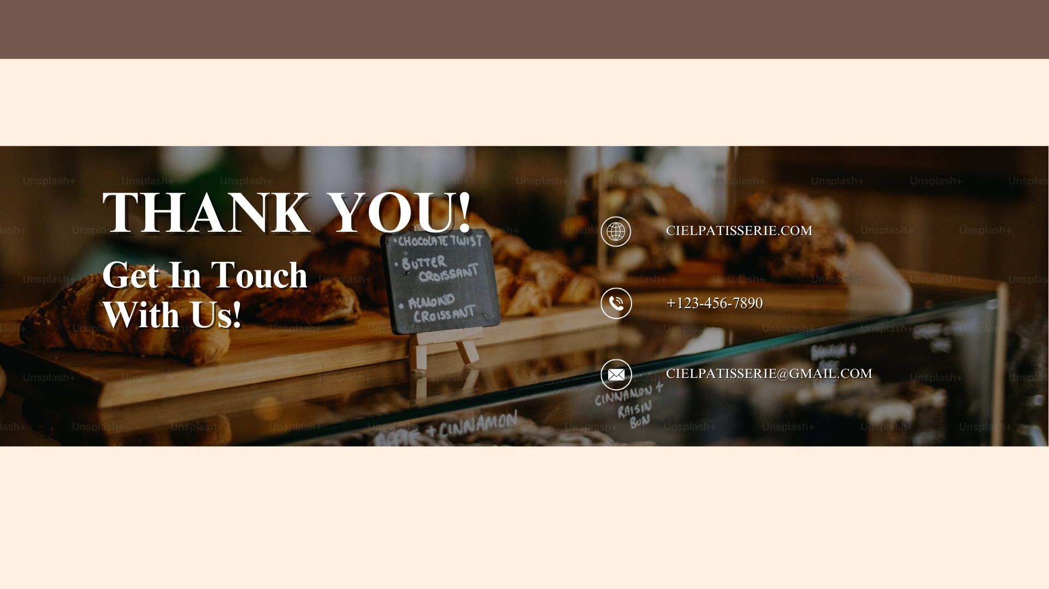

Slide 11
Thank you!

